Slide 1
B2.2 Data Structures
B2.2.1 Compare static and dynamic data structures

Slide 2
Starter
Seating vs Snacks
Imagine you are selling tickets for a school concert with a fixed number of seats.
Can you sell more tickets than there are seats?"
Discuss why this number must be fixed (to avoid complaints).

Slide 3
LINEAR SEARCH

Slide 4
Extension
You are also selling snacks and drinks, but you don’t know how many you will sell.
How can you keep track of snacks sold if the number changes all the time?

Slide 5
Data Structure
A data structure is a way of organizing and storing data in a computer so it can be accessed and used efficiently. It combines data values, the relationships among them, and the operations you can perform on the data. Data structures help manage data in programs, making storage, retrieval, and manipulation faster and more effective

Slide 6
Why Data Structures Matter
Allow efficient searching and sorting of information
Help manage big amounts of data
Make it easier to program complex applications, like databases, operating systems, and AI.
In short, data structures are the building blocks for creating fast and powerful computer programs

Slide 7
Main Types of Data Structures
Linear: Data is arranged in a sequence (like a line). Examples: arrays, stacks, queues, linked lists.
Non-linear: Data is arranged in a branching structure. Examples: trees, graphs.

Slide 8
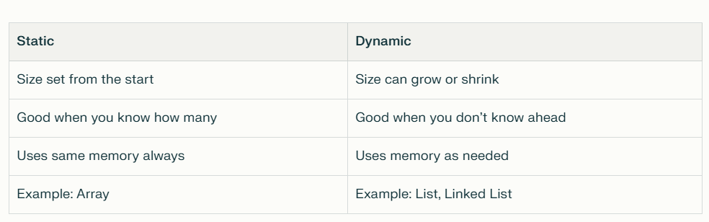

Slide 9
Super Simple Example
Static: An array for exactly 10 tickets.
Dynamic: A list for drinks sold—you don’t know the number, it changes during the event.

Slide 10
What is a Static Data Structure?
Fixed size: Number of items is set from the start (like concert seats).
If you need 100 seats, your data structure has 100 slots. No more, no less.
You cannot change the size while the program runs.

Slide 11
What is a Dynamic Data Structure?
Flexible size: Number of items can grow or shrink (like selling snacks).
List gets longer as you add new items, and shorter as you remove them.
You don't need to know the size ahead of time.

Slide 12
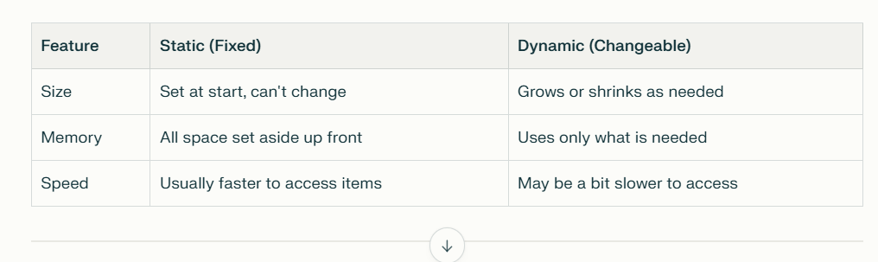

Slide 13
Real -life examples
Static (Fixed spots): Student register for one class, parking lot, seats at a theatre.
Dynamic (Changeable): Waiting list for tickets, snack sale list, sign-ups for clubs.

Slide 14
When to Use Which?
Use static if you know the number from the start.
Use dynamic if the number can change or you don’t know it ahead of time.

Slide 15
IB Exam Style Questions
Define a static data structure and give one example.
(2 marks)
Define a dynamic data structure and give one example.
(2 marks)
Explain one advantage of using a static data structure over a dynamic data structure.
(2 marks)
Explain one advantage of using a dynamic data structure instead of a static one.
(2 marks)
A concert has 200 fixed seats and sells snacks with an unknown quantity.
(a) Suggest which type of data structure should be used to store the seating information and explain why.
(b) Suggest which type of data structure should be used to store the snacks sold and explain why.
(4 marks)
Outline one disadvantage of static data structures relating to memory usage.
(1 mark)
Explain why dynamic data structures might be slower than static data structures when accessing elements.
(2 marks)
Compare arrays and linked lists as examples of static and dynamic data structures respectively. Highlight one key difference.
(3 marks)

